Slide 2

States’ Legal Obligations to provide assistance to aircraft accident victims and their families
Fernando Camargo
NACC Regional Officer, Technical Assistance
Notes:
Good morning, ladies and gentlemen. The subject of this presentation is the set of legal responsibilities that States have when an aviation accident occurs. More specifically, we are going to look at what the international framework — the Chicago Convention, its Annexes, ICAO Assembly resolutions, and ICAO guidance material — says about supporting victims and their families. This is an area where law and humanity meet. On the one hand, States must comply with legal duties. On the other hand, families in crisis expect compassion, dignity, and real help.

Slide 3
Objective
Inspire participants to treat family assistance as a binding duty and to strengthen laws, coordination, and plans within their own States
Notes:
The purpose of this session is to encourage everyone here to see family assistance not just as a recommendation, but as both a legal duty and a moral responsibility. What we expect is a shift from awareness to action: that each of you, in your own role and organisation, will work to strengthen the laws, the coordination structures, and the practical plans that make family assistance effective in real life.

Slide 4
Agenda
Humanitarian Imperative and Legal Duties
ICAO Standards and Recommended Practices – Annex 9
ICAO Policy and Manual Guidance
The State’s Obligation to Establish and Coordinate a Family Assistance System
Roles of Key Stakeholders and International Participation
The OECS Context – The Role of Coordination
Legislative and Policy Requirements
Implementation and Good Practices

Slide 5
Agenda
Humanitarian Imperative and Legal Duties
ICAO Standards and Recommended Practices – Annex 9
ICAO Policy and Manual Guidance
The State’s Obligation to Establish and Coordinate a Family Assistance System
Roles of Key Stakeholders and International Participation
The OECS Context – The Role of Coordination
Legislative and Policy Requirements
Implementation and Good Practices

Slide 6
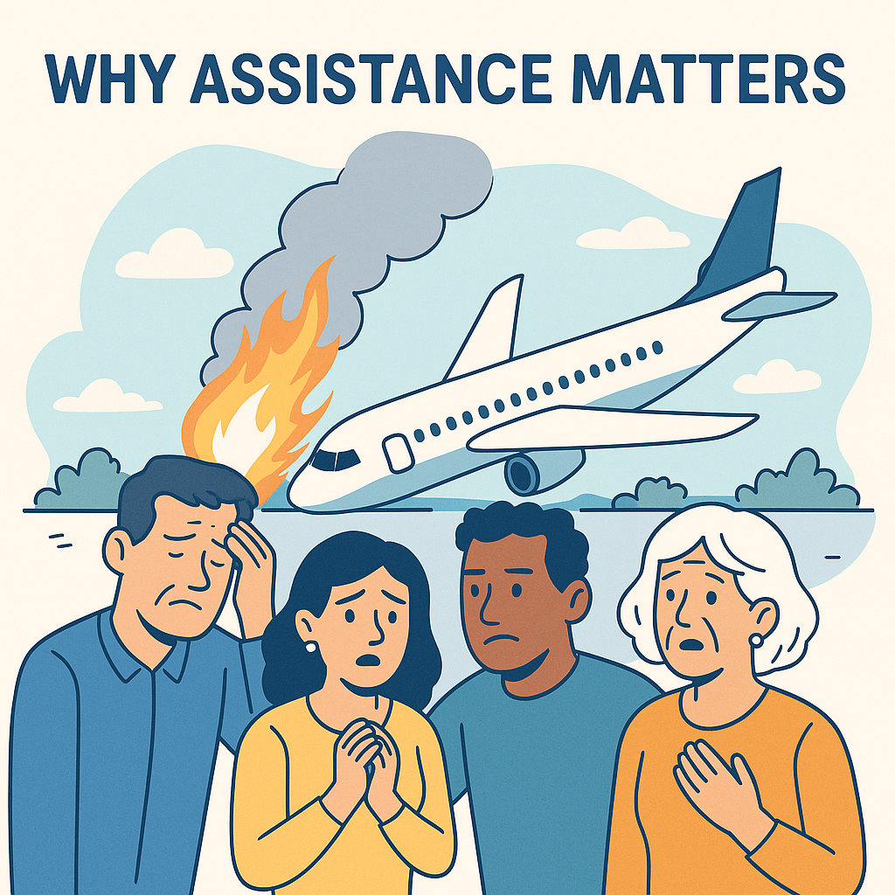
Why assistance matters
Aviation is safe, but accidents cannot be fully eliminated
Families face trauma, loss, uncertainty
Assistance is a humanitarian and legal obligation
Notes:
Although air travel is the safest way to move around the world, it is impossible to eliminate the risk of serious accidents. When such accidents occur, the families of victims are left devastated. They face not only loss and trauma, but also confusion and uncertainty in a very difficult moment. For this reason, the international community recognises that assistance to families is not simply a courtesy. It is both a humanitarian necessity and a legal duty, and States must be prepared to provide it.

Slide 7
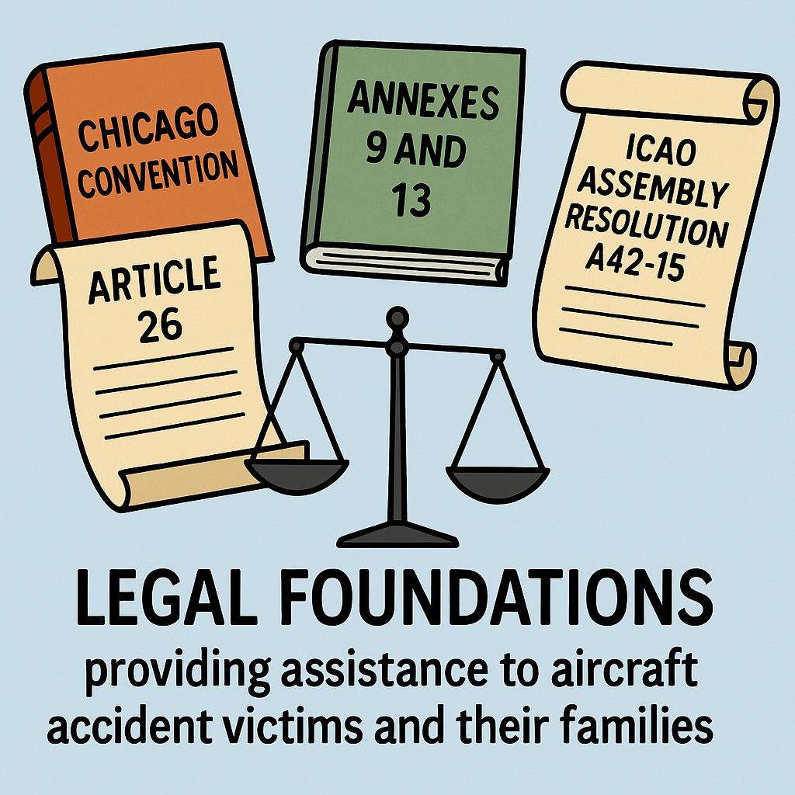
Legal foundations
Chicago Convention (Art. 26) – obligation to investigate
Annex 9 – Family assistance provisions
Annex 13 – Investigation vs. family needs
Assembly Resolution A42-15 – updated policy on assistance to victims and families
Notes:
The legal basis is very clear. Article 26 of the Chicago Convention obliges a State where an accident happens to conduct an investigation. Annex 13 provides the detailed Standards and Recommended Practices for those investigations, but its focus is safety and prevention, not liability. Families, however, need more than the findings of a safety report. That is why Annex 9 includes specific provisions addressing family assistance. Assembly Resolution A42-15 expands this commitment, making it a core ICAO policy objective. It reaffirms that States must enact legislation and policies to support victims and their families, as now required under Annex 9 Standard 8.47, and it calls for better implementation and reporting of these obligations.

Slide 8
Agenda
Humanitarian Imperative and Legal Duties
ICAO Standards and Recommended Practices – Annex 9
ICAO Policy and Manual Guidance
The State’s Obligation to Establish and Coordinate a Family Assistance System
Roles of Key Stakeholders and International Participation
The OECS Context – The Role of Coordination
Legislative and Policy Requirements
Implementation and Good Practices

Slide 9
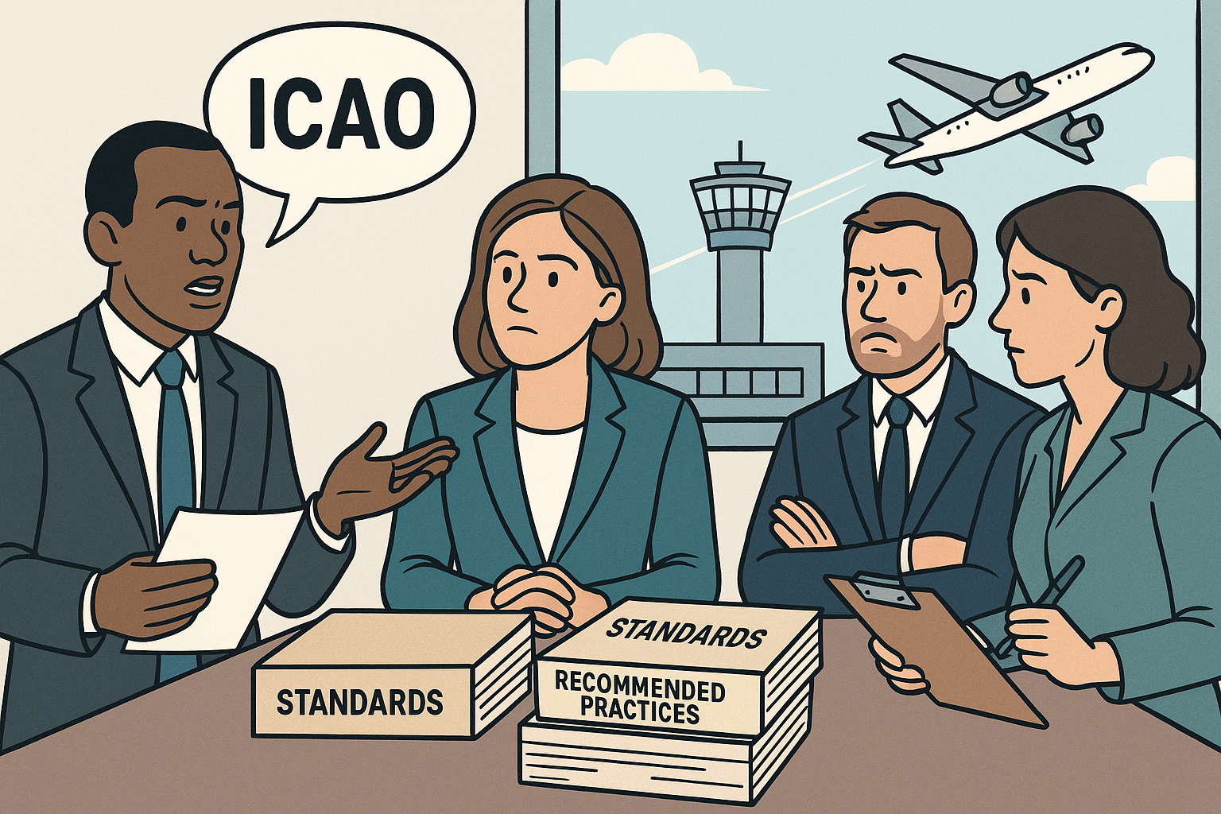
Annex 9 (Facilitation) – Key SARPs
Facilitate entry and stay of family members (8.38)
Expedite visas and immigration for families (8.40)
Issue emergency travel documents for survivors (8.41)
Notes:
Annex 9, which deals with facilitation, contains binding Standards on family assistance. It makes it clear that States must actively facilitate the entry and stay of family members in the State of Occurrence, ensuring that they do not face unnecessary administrative barriers during such a difficult time. Standard 8.40 requires that visas and immigration processes be expedited so that relatives can reach their loved ones without delay. When survivors themselves do not have the necessary documents, States must issue emergency travel papers to allow them to travel or return home safely. Assembly Resolution A42-15 reinforces these obligations, calling on States to improve their implementation and to ensure that families receive the timely support and access they need.

Slide 10
Annex 9 (Facilitation) – Key SARPs
Return of remains and personal effects (8.42)
States shall establish family assistance legislation (8.43)
Ensure aircraft and airport operators develop appropriate assistance plans (8.44)
Notes:
Annex 9 continues with further obligations directly related to family assistance. Standard 8.42 requires States to ensure the return of victims’ remains and personal effects with dignity and without unnecessary delay. Standard 8.43 makes it mandatory for every Contracting State to establish legislation, regulations, or policies in support of assistance to aircraft accident victims and their families. It also refers States to ICAO Doc 9998 and Doc 9973 for policy guidance and implementation details. Standard 8.44 then requires aircraft and airport operators to develop and maintain family assistance plans, ensuring that practical arrangements are in place for immediate activation when an accident occurs. Assembly Resolution A42-15 reinforces these obligations, urging all States to ensure full implementation of Annex 9 provisions, to review their national legislation and plans in light of the ICAO policy and manual, and to report their level of compliance through the EFOD system.

Slide 11
Agenda
Humanitarian Imperative and Legal Duties
ICAO Standards and Recommended Practices – Annex 9
ICAO Policy and Manual Guidance
The State’s Obligation to Establish and Coordinate a Family Assistance System
Roles of Key Stakeholders and International Participation
The OECS Context – The Role of Coordination
Legislative and Policy Requirements
Implementation and Good Practices

Slide 12

Doc 9998 – ICAO Policy
Framework for State readiness
Defines responsibilities (State, operator, NGOs, airports)
Emphasises timeliness and coordination
Notes:
ICAO Doc 9998 sets out the official policy framework for how States should prepare to assist victims of aircraft accidents and their families. It makes clear that this is a State responsibility, requiring readiness and coordination before an accident occurs. The policy defines clear roles for governments, operators, airports and support organisations, ensuring that everyone knows what to do when a crisis happens. It emphasises that assistance must be timely, coordinated, and delivered with compassion. The document also calls for effective communication with families, both to share factual information and to address their emotional and practical needs.

Slide 13
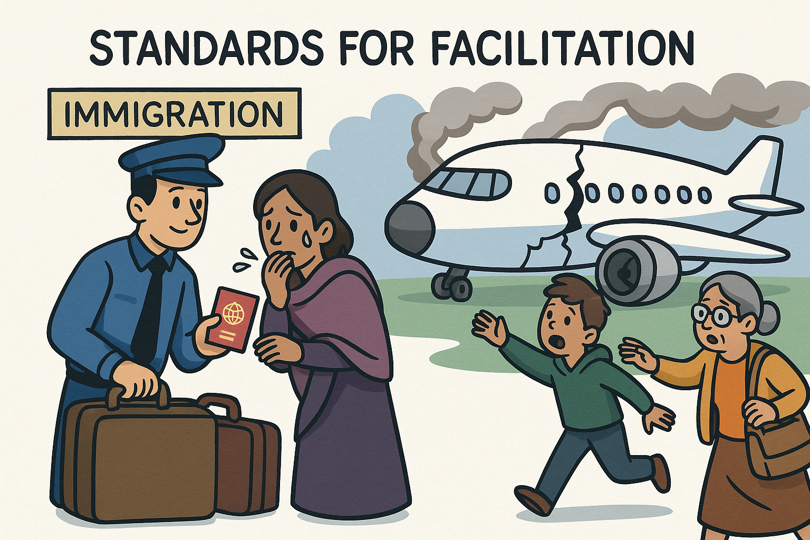
Doc 9973 – ICAO Manual
Guidance on services: counselling, medical care, financial help
Handling of personal effects
Respect for cultural and religious considerations
Communication and privacy
Notes:
Doc 9973 gives practical guidance on what States should actually do. It covers the services families need most: psychological counselling, medical support, and sometimes immediate financial help. It explains how to handle personal effects with care, ensuring that they are returned respectfully. It highlights the need to respect cultural and religious traditions in such sensitive circumstances. And it reminds us of the importance of communication — providing accurate information, protecting privacy, and treating families with sensitivity.

Slide 14
Agenda
Humanitarian Imperative and Legal Duties
ICAO Standards and Recommended Practices – Annex 9
ICAO Policy and Manual Guidance
The State’s Obligation to Establish and Coordinate a Family Assistance System
Roles of Key Stakeholders and International Participation
The OECS Context – The Role of Coordination
Legislative and Policy Requirements
Implementation and Good Practices

Slide 15

Obligations of the State of Occurrence
Establish comprehensive family assistance system
Appoint a national coordinator with legal authority
Ensure plans are ready for immediate activation
Notes:
The State of Occurrence — the country where the accident happens — has the primary responsibility for family assistance. It must set up a system that covers all aspects of support. It must appoint a coordinator with real legal authority, not just a symbolic role. And it must make sure that plans are in place and ready to be activated without delay. Assistance cannot be improvised after an accident; it has to be prepared in advance.

Slide 16

Coordinator’s role
Mobilise and direct all stakeholders
Oversee operators’ family assistance plans
Act as central point of contact for families and foreign States
Notes:
The coordinator is at the heart of the system. They must be able to bring together and guide all the key actors: government agencies, operators, airports, and non-governmental organisations. They are responsible for checking that operators have proper assistance plans in place and that these plans are workable. They are also the main point of contact for families, who need reliable and consistent information, and for foreign States whose citizens may have been involved. Without a strong coordinator, the entire assistance effort risks becoming fragmented and ineffective.

Slide 17
Agenda
Humanitarian Imperative and Legal Duties
ICAO Standards and Recommended Practices – Annex 9
ICAO Policy and Manual Guidance
The State’s Obligation to Establish and Coordinate a Family Assistance System
Roles of Key Stakeholders and International Participation
The OECS Context – The Role of Coordination
Legislative and Policy Requirements
Implementation and Good Practices

Slide 18

Main actors
Government – coordination and legislation
Accident Investigation Authority – factual updates
Civil Aviation Authority – oversight
Operator/Airport – direct assistance
Notes:
Family assistance is a shared responsibility. The government provides legislation and overall coordination. The accident investigation authority updates families with factual information from the inquiry. The Civil Aviation Authority makes sure that all obligations are met. And operators and airports provide the direct support on the ground — transport, accommodation, and practical help for families.

Slide 19

Other contributors
NGOs and Red Cross – humanitarian support
Family associations – advocacy and liaison
Foreign States – consular support and expert participation under Annex 13 (5.27)
Notes:
In addition to the main actors, other contributors play a crucial role in family assistance. Non-governmental organisations and the Red Cross can provide humanitarian support, from counselling and logistics to immediate relief services. Family associations act as advocates for the relatives and help maintain communication with authorities.
Foreign States also have a recognised role when their citizens are involved. Consular services are often the first line of support, helping families with travel, documentation, and practical needs. Beyond this, Annex 13, paragraph 5.27, gives States whose citizens are among the victims the right to appoint an expert. This expert may visit the accident site, receive factual information cleared for public release, and obtain a copy of the final report. This provision strengthens cooperation and ensures that the interests of families from abroad are taken into account throughout the process.

Slide 20
Agenda
Humanitarian Imperative and Legal Duties
ICAO Standards and Recommended Practices – Annex 9
ICAO Policy and Manual Guidance
The State’s Obligation to Establish and Coordinate a Family Assistance System
Roles of Key Stakeholders and International Participation
The OECS Context – The Role of Coordination
Legislative and Policy Requirements
Implementation and Good Practices

Slide 21

Options for compliance
National family-assistance coordinating body
Regional mechanism, possibly under ECCAA
Notes:
In the OECS region, there are two possible approaches. One is for each State to set up its own national coordinator, fully integrated into national emergency structures. The other is to create a regional mechanism, for example through ECCAA. Both options meet ICAO obligations, but they have different implications for resources, coordination, and sovereignty.

Slide 22

National approach – advantages and challenges
Advantages:
Preserves national sovereignty and accountability
Coordinator embedded in national emergency management structures
Challenges:
Limited resources and expertise in small States
Risk of inconsistency across the OECS
Notes:
The national model keeps responsibility in each State’s hands. It ensures sovereignty and allows the coordinator to be part of the national emergency system. But small States may struggle with limited resources and expertise. And having several different systems in the region could lead to inconsistencies in how assistance is provided.

Slide 23

Regional approach – advantages and challenges
Advantages:
Shared expertise, economies of scale
Harmonised procedures across States
Stronger collective voice in international fora
Challenges:
Requires high political commitment and legal harmonisation
Possible perception of reduced national control
Notes:
A regional model allows States to share expertise and resources, which saves costs and improves consistency. Procedures can be harmonised, and the region gains a stronger collective voice internationally. The challenges are significant: it requires political will, legal harmonisation, and some may fear that national control is reduced.

Slide 24

Key requirement – clear authority
Coordinator must have legal power to:
require operators to maintain family-assistance plans
act as the focal point for cooperation with national agencies and foreign States
ensure harmonised procedures and provide technical expertise
Notes:
Whichever model is chosen, the system will only work if the coordinator has clear legal authority. They must be able to require operators to maintain family-assistance plans. They must be recognised as the official focal point for cooperation with agencies at home and with foreign States abroad. And they must be able to ensure harmonisation and provide technical guidance. Without this authority, the system cannot succeed.

Slide 25
Agenda
Humanitarian Imperative and Legal Duties
ICAO Standards and Recommended Practices – Annex 9
ICAO Policy and Manual Guidance
The State’s Obligation to Establish and Coordinate a Family Assistance System
Roles of Key Stakeholders and International Participation
The OECS Context – The Role of Coordination
Legislative and Policy Requirements
Implementation and Good Practices

Slide 26
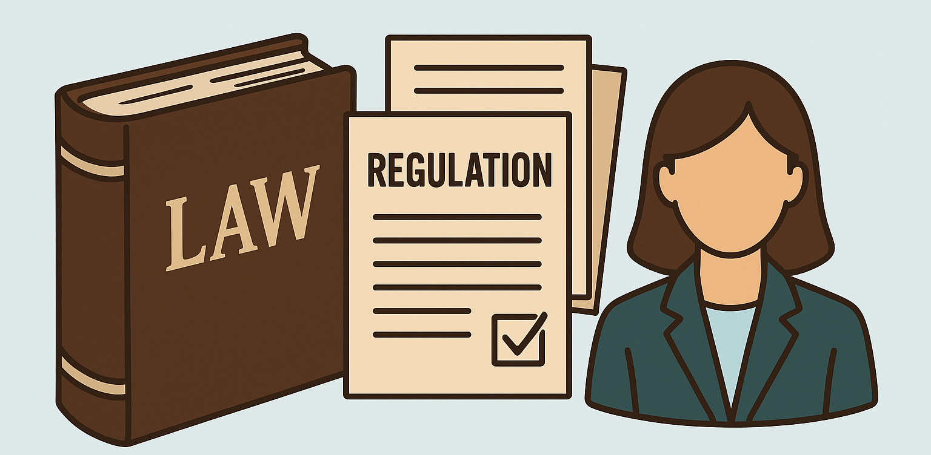
Legislative requirements
Primary law: national family assistance obligations
Regulations: operator plans, audits, enforcement
Coordinator: legal powers and accountability
Notes:
The foundation of a good family assistance system is legislation. States need primary laws that create family-assistance obligations. They also need regulations that require operators to have assistance plans and to submit to audits. And the law must give the coordinator the powers necessary to enforce these requirements. Without a legal base, the system has no real strength.

Slide 27

Link with ICAO Critical Elements
CE-1: Primary legislation must include family assistance
CE-2: Regulations must require operator and airport plans
CE-3: States must have systems to enforce obligations
Regular EFOD reporting required under Assembly Resolution A42-15
Notes:
Family assistance is not only a humanitarian or political commitment; it is part of ICAO’s safety oversight framework. Under the Universal Safety Oversight Audit Programme, ICAO audits States against the Critical Elements. CE-1 requires States to have primary aviation legislation that covers all international obligations, and that includes family assistance. CE-2 looks at whether there are operating regulations in place to make the obligations effective — for example, requiring operators and airports to maintain assistance plans. CE-3 examines whether the State has the organisation, functions, and resources needed to enforce these obligations. So, if a State fails to legislate or regulate family assistance, this will not only affect families, it will also show up as a gap in ICAO’s audit results. Assembly Resolution A42-15 further highlights that compliance remains low and urges States to report their level of implementation through the EFOD system to improve transparency and oversight.

Slide 28
Agenda
Humanitarian Imperative and Legal Duties
ICAO Standards and Recommended Practices – Annex 9
ICAO Policy and Manual Guidance
The State’s Obligation to Establish and Coordinate a Family Assistance System
Roles of Key Stakeholders and International Participation
The OECS Context – The Role of Coordination
Legislative and Policy Requirements
Implementation and Good Practices

Slide 29

Effective family assistance systems
National/Regional assistance plans
Pre-arranged MOUs with NGOs and operators
Training and regular exercises
Notes:
To be effective, family assistance systems must be planned and tested in advance. There should be national or regional assistance plans that set out clearly how support will be provided. Memoranda of understanding with non-governmental organisations and operators should be signed before an accident takes place. And regular training and exercises are vital to ensure that everyone knows their role and can act quickly when needed.

Slide 30

Sustainability and improvement
Continuous review after real events or drills
Feedback from families
Integration into national emergency management
Share lessons learned and best practices with ICAO and other States (A42-15)
Notes:
Family assistance systems cannot remain static. They need to be reviewed after every accident or exercise. Families should be asked for feedback on what worked and what did not, so improvements can be made. And the system must be fully integrated into the State’s wider emergency management framework, so that it does not operate in isolation. Assembly Resolution A42-15 also stresses the importance of sharing lessons learned and effective practices with other States and with ICAO, so that the collective experience can strengthen the global capacity to support victims and families.

Slide 31
Agenda
Humanitarian Imperative and Legal Duties
ICAO Standards and Recommended Practices – Annex 9
ICAO Policy and Manual Guidance
The State’s Obligation to Establish and Coordinate a Family Assistance System
Roles of Key Stakeholders and International Participation
The OECS Context – The Role of Coordination
Legislative and Policy Requirements
Implementation and Good Practices

Slide 32

Family assistance: a State obligation, a human responsibility
Notes:
Let me conclude with this message: providing assistance to victims and their families is not optional. It is both a legal duty under ICAO rules and a moral imperative. Families who suffer the shock of an accident deserve dignity, respect, and proper support. It is our collective responsibility to make sure that happens, every time.

