Slide 1

Topic: Safety oversight and audit activities cooperation – Ground Operations Standards and ICAO provisions
Floyd Abang
Americas region Ground Operations Lead
Operations, Safety & Security (OSS)

Slide 2

Table of Content
Introduction
Ground Handling Incidents Linked to Non-Compliance
GOSM Ed.10 Rev1 & AHM Ed.46 Overview
GOSM Ed.10 Rev1 & IGOM Ed.14 Overview
Implications for Ground Handling Service Providers
Summary of Standards Alignment
Conclusion and Next Steps
What is needed
ICAO Doc 10121 & AHM Ed.46 Overview
ICAO Doc 10121 & IGOM Ed.14 Overview
ICAO Doc10121 & GOSM Ed.10 Rev1 Overview
Notes:
ICAO Doc 10121 – Manual on Ground Handling
AHM Ed.46 - Airport Handling Manual
GOSM Ed.10 Rev1 – Ground Operations Standards Manual
IGOM Ed.14 - IATA Ground Operations Manual
Correlation tables – found in the AHM toolbox/resources section

Slide 3
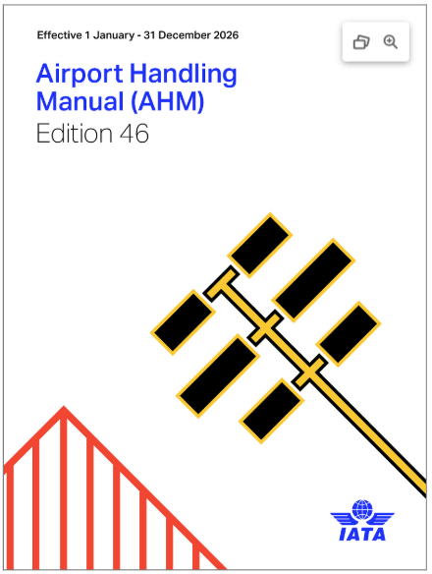
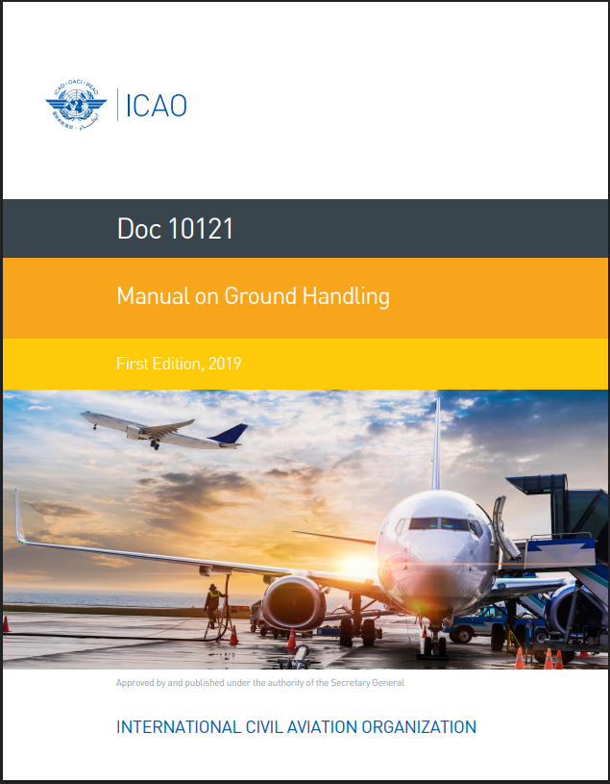
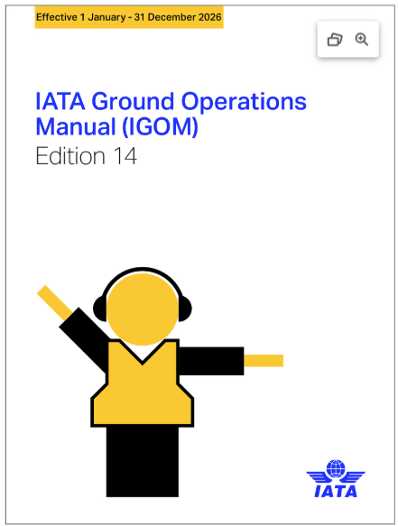
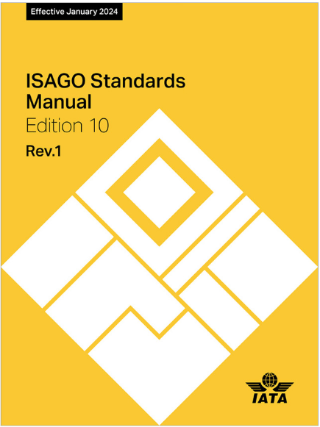
Introduction
Harmonizing Global Standards
Unification of ICAO and IATA standards to improve ground handling safety and efficiency worldwide.
Roles of Key Documents
ICAO Doc 10121 sets international guidelines; AHM and IGOM provide detailed procedures and consistency, with the GOSM providing the verification process.
Scope of Correlations
Includes safety protocols, equipment handling, documentation, and service provider responsibilities in ground operations.
Benefits of Alignment
Unified standards reduce risks, improve service quality, and ensure operational consistency across stakeholders.
Notes:
`Unification of ICAO and IATA standards – correlations tables created to enables stakeholders identify the applicability to Global provisions

Slide 4
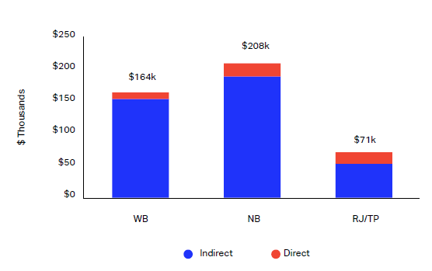
Ground Handling Incidents Linked to Non-Compliance
Ramp Accidents – Global Trends
Data: Estimated 27,000 ramp accidents annually.
Common Causes: Miscommunication, procedural violations, equipment misuse.
Potential Standards Breached: ICAO Doc 10121, AHM Chapter 660, IGOM safety protocols.
Impact: $10B annual cost, injuries, operational disruptions
Ground damage cost – per incident basis
Source: IATA Ground Damage Report
Source: Flight Safety FoundationIAeroSafetyWordIAugust 2012

Slide 5

ICAO Doc 10121 & AHM Ed.46 Overview Correlation Tables
ICAO 4.1 – Organizational Requirements for a GHSP
AHM601 – Organization and management
ICAO Doc 10121 | AHM REFERENCES
4.1 | AHM601 sec 1.2.1, sec 2.1, AHM610 sec 3,
4.2.4 | AHM601 sec 1.5.1, AHM610 sec 4.1.1
4.6 | AHM601 sec 13.1, 13.2, AHM460, AHM1110 sec 4, sec 11, AHM601 sec 1.5.3
ICAO 4.1.1 - The GHSP should have a documented organizational structure commensurate with the size and
complexity of its operations.
AHM 1.2.1 - A management system is the framework for a company’s policies, processes, and procedures to ensure it fulfills all the tasks required to achieve its objectives
Notes:
AHM 601 – Organization and management
AHM910 – Basic requirements applicable to aircraft ground support equipment
AHM1110 - Ground Operations Training Program
1.2 Management System
1.2.1 Principles
A management system is the framework for a company’s policies, processes, and procedures to ensure it fulfills all the tasks required to achieve its objectives
The management system ensures compliance with internal corporate standards and the applicable laws and regulations of all states where the company operates
To maintain safety and security standards in operations, each company shall have a management system that ensures:
Key policies, systems, programs, procedures, and plans are developed and implemented throughout the company.
Lines of accountabilities, responsibilities, and authorities for safety and security are defined companywide. (See AHM 601 section 1.5.1–1.5.2)
Resources and training are provided to conduct operations in accordance with company standards, applicable laws and regulations, and customer airlines’ requirements. (See AHM 601 section 1.6 and AHM 1110)
Systemic company cultures are fostered around safety, security, and just culture. (See AHM 601 section 1.4)
ICAO 4.2.4 SMS Element 1.1 — Management commitment
AHM601 1.5.1 Accountable Executive- A company shall identify one senior management official as the Accountable Executive (AE) who is accountable for the management system’s performance
AHM 610 4.1.1 - 4.1.1 Safety Policy
A company’s safety policy reflects management’s commitment to safety and implementing a SMS.
A safety policy is a statement of a company’s intent regarding SMS implementation and its commitment to achieving its safety objectives.
A management system is documented in controlled company media at the corporate and station levels. Manuals or controlled electronic media are an acceptable means of documenting the management system.
Safety Management System (SMS) is a framework of policies, processes, procedures, and techniques for a company to monitor and continuously improve its safety performance by making informed decisions on managing operational safety risks. Specifications for a SMS are derived from global standards as documented in ICAO Annex 19.

Slide 6

ICAO Doc 10121 & IGOM Ed.14 Overview Correlation Tables
Doc. 10121 - 6.2.2.6 GHSPs should ensure their vehicles and personnel comply with the aerodrome driving rules.
IGOM Ed.14 - 3.1.3.1 General Safety Instructions (procedures whenever operating GSE on the ramp)
ICAO Doc 10121 | IGOM REFERENCES
6.2.2.6 | 3.1.3.1, 3.1.3.2, 3.1.3.3, 3.1.3.4
6.3.3.7 | 3.4, 4.1.1, 4.6.2.3, 4.6.6.4
6.3.12.5 | 3.8
Notes:
Doc. 10121 - 6.2.2.6 - High level policy statement
IGOM - 3.1.3.1 – Provides detailed procedures when operating GSE on the ramp (e.g. when operating any GSE, operator needs to check the aircraft for possible damage in the equipment contact zone before positioning and after removal of GSE to/from the aircraft)
3.1.3.1 General Safety Instructions
Apply these procedures whenever operating GSE on the ramp:
Personnel shall only drive or operate GSE if trained and authorized for that specific equipment type.
GSE shall not be moved or driven across the path of:
Taxing aircraft or aircraft under tow/pushback
Embarking and disembarking passengers on the ramp
Emergency vehicles.
When operating any GSE, check the aircraft for possible damage in the equipment contact zone before positioning and after removal of GSE to/from the aircraft.
Immediately report any damage found, or where contact has taken place or is suspected to have taken place, especially for composite aircraft.
Where damage has been found or where contact has taken place or is suspected to have taken place, do not move any GSE to/from the aircraft in the area where damage has been found until inspection is completed, and clearance given to proceed.
Personnel working with and around vehicles and equipment must protect themselves from loose clothing, long hair, and/or hanging accessories/jewelry from becoming a hazard, e.g., caught or trapped in equipment.

Slide 7

ICAO Doc10121 & GOSM Ed.10 Rev1 Overview Correlation Tables
ICAO Doc 10121 | GOSM REFERENCES
4.1 | ORM 1.1.1, ORM 1.1.3, ORM 3.1.1
6.2.4.2 | HDL 1.2.7, HDL 1.2.8 iii), HDL 1.2.11, HDL 1.2.12, HDL 1.4, HDL Table 1 - Airside Driver Training
6.3.2.2 | LOD 1.1.1, LOD 2.3.1
6.3.3.5 | AGM 1.1.1, AGM 1.1.2
HDL 1.2.7 (GOSM) The provider shall have procedures to ensure the movement of GSE operated in close proximity to aircraft, when the vision of the GSE operator is or might be restricted, is directed by one or more guide persons
6.2.4.2 (Doc 10121) GHSPs should pay special attention to the risks associated with equipment moving in close proximity to or approaching the aircraft, and ensure their personnel are trained according to the rules provided by the air operators.
Notes:
1.2 Ground Support Equipment (GSE)
HDL 1.2.7 The provider shall have procedures to ensure the movement of GSE operated in close proximity to aircraft, when the vision of the GSE operator is or might be restricted, is directed by one or more guide persons and:
Hand signals are utilized by the guide person(s).
The guide person(s) is (are) positioned so that clearance from the aircraft, other equipment, vehicles or facilities can be accurately judged, and signals can be visually communicated to the GSE operator.
If visual contact with the guide person(s) is lost, the GSE operator stops movement of the GSE immediately. (GM)
ICAO - 6.2.4 Equipment approaching the aircraft
Air operator
6.2.4.1 The risks associated with equipment moving in close proximity to or approaching the aircraft are significant and are a main cause of damage to aircraft. Air operators should define the rules to be followed regarding all equipment
approaching an aircraft, including but not limited to speed, brake checks, situations where a guide person is needed, clearance from the fuselage and equipment chocking.
GHSP
6.2.4.2 GHSPs should pay special attention to the risks associated with equipment moving in close proximity to or approaching the aircraft, and ensure their personnel are trained according to the rules provided by the air operators.
6.2.4.3 GHSPs should ensure GSE servicing the aircraft avoids any contact with the fuselage, especially GSE servicing aircraft doors, this is often referred to as a “no-touch policy” (some exceptions can be considered such as
passenger boarding equipment).

Slide 8

GOSM Ed.10 Rev1 & AHM Ed.46 Overview Correlation Tables
GOSM REFERENCES | AHM REFERENCES
ORM 1.1.1 Organization and Management (ORM) | AHM 601 Section 1.2.1
ORM 2.1.1 | AHM 601 Section 10, AHM 910
ORM 3.1.1 | AHM 601 Section 2.1
ORM 4.1.1 | AHM 601 Section 1.5.3
ORM 1.1.1 (GOSM) The provider shall have a management system that ensures - Resources necessary to conduct operations in accordance with the standards of the provider, applicable laws and regulations, and the requirements of the customer airline(s) are always guaranteed
1.2.1 (AHM) Principles - The management system ensures compliance with internal corporate standards and the applicable laws and regulations of all states where the company operates
Notes:
GOSM (Management and Control)
1.1 Organization and Accountability
ORM 1.1.1 The provider shall have a management system that ensures:
Key policies, systems, programs, processes, procedures and/or plans are determined and implemented throughout the organization.
Lines of accountability for operational safety and security are defined throughout the organization.
Resources necessary to conduct operations in accordance with the standards of the provider, applicable laws and regulations, and the requirements of the customer airline(s) are always guaranteed. (GM)
AHM (Organization and management control)
1.2.1 Principles
A management system is the framework for a company’s policies, processes, and procedures to ensure it fulfills all the tasks required to achieve its objectives
The management system ensures compliance with internal corporate standards and the applicable laws and regulations of all states where the company operates
To maintain safety and security standards in operations, each company shall have a management system that ensures:
Key policies, systems, programs, procedures, and plans are developed and implemented throughout the company.
Lines of accountabilities, responsibilities, and authorities for safety and security are defined companywide. (See AHM 601 section 1.5.1–1.5.2)
Resources and training are provided to conduct operations in accordance with company standards, applicable laws and regulations, and customer airlines’ requirements. (See AHM 601 section 1.6 and AHM 1110)
Systemic company cultures are fostered around safety, security, and just culture. (See AHM 601 section 1.4)
A management system is documented in controlled company media at the corporate and station levels. Manuals or controlled electronic media are an acceptable means of documenting the management system.
Some of the sections have additional references from IATA AHM
Some of the ORM sections have additional references from IATA ULDR manual and IGOM

Slide 9

GOSM Ed.10 Rev1 & IGOM Ed.14 Overview Correlation Tables
GOSM REFERENCES | IGOM REFERENCES
PAB 1.1.1 Passenger and Baggage (PAB) | 1.1.3.1,1.1.4.1,1.1.4.2, 1.1.5
AGM 1.1.3 Aircraft Ground Movement (AGM) | 3.1.2, 4.1.1, 4.1.3, 4.3, 4.2
HDL 1.1.1 Aircraft Handling and Loading (HDL) | 4.4
LOD 1.1.1 Load Control (LOD) | 5.4, 5.7
1.1.3.1 (IGOM) Passenger Check-in: Check-in is the complete sequence of steps that involves the acceptance of passengers and their baggage in a DCS or manual system, the labelling of the baggage and the issuance of one or more boarding passes. Boarding passes holding the accepted passenger’s name and additional unique identifying data must be issued to each passenger, either on paper or electronically.
PAB 1.1.1 (GOSM) The provider shall have procedures to ensure a boarding pass is issued to each seated passenger during the check-in process. The boarding pass shall contain the name of the passenger as recorded in an official identity document or card and matching the name contained in the flight reservation
Notes:
PAB (Section 3)
1. Operational Procedures
1.1 Check-in
PAB 1.1.1 The provider shall have procedures to ensure a boarding pass is issued to each seated passenger during the check-in process. The boarding pass shall contain the name of the passenger as recorded in an official identity document or card and matching the name contained in the flight reservation. (GM)
AGM (Section 6)
AGM 1.1.3 The provider shall have procedures, in accordance with requirements of customer airline(s), to ensure that, for each aircraft arrival, all personnel and equipment must remain clear from engine danger areas, including intake, blast and propeller rotation, as applicable, and the following conditions are met:
Upon aircraft stopping:
Wheel chocks are placed at nose landing gear wheels, if applicable.
Ground power unit is connected, if applicable.
As engines are spooling down and after anti-collision lights have been switched off:
Chocks are positioned on main landing gear and verbal or visual confirmation is given to flight deck crew.
Cabin door and surrounding area is inspected for existing damage before positioning boarding devices.
Safety cones are positioned, as per aircraft type.
Walkaround inspection, as specified in AGM 1.1.4, is performed prior to giving clearance for GSE to position at aircraft. (GM)
HDL (Section 5)
1. Operational Procedures
1.1 Aircraft Access
HDL 1.1.1 The provider shall have a process that ensures the operation of aircraft access doors, applicable to each type of aircraft, is in accordance with the requirements of the customer airline(s) served at the station. (GM)
LOD (Section 2)
1.1 Process Management and Information Communication
LOD 1.1.1 The provider shall have a load control process that includes communication, information and procedures for the following elements:
Provision of information required for weight and balance calculations
Use of operator-approved coding scheme and passenger and baggage weights
Calculating and communicating provisional load planning data
Load planning and Load Instruction Report (LIR) production
Supervision of the loading and offloading of the aircraft
Reporting and recording the loading of the aircraft and load finalization
Load sheet production
Last Minute Change (LMC) process
Managing discrepancies
Transmission of post-departure messages and reports
Records and filing
Roles and responsibilities (GM)
IGOM (1.1.3 Passenger Check-In)
1.1.3.1 Passenger Check-in - General
Check-in is the complete sequence of steps that involves the acceptance of passengers and their baggage in a DCS or manual system, the labelling of the baggage and the issuance of one or more boarding passes. Boarding passes holding the accepted passenger’s name and additional unique identifying data must be issued to each passenger, either on paper or electronically.
Some of the sections have additional references from IATA AHM

Slide 10

Implications for Ground Handling Service Providers
Regulatory Compliance
Aligning with ICAO, AHM, and IGOM standards ensures adherence to international regulations, reducing risks of penalties and disruptions. Validation/verification accomplished through GOSM.
Operational Efficiency
Standardized procedures enhance efficiency by minimizing errors and inconsistencies in ground handling processes.
Safety Enhancements
Improved safety protocols protect personnel and equipment, fostering a safer aviation environment.
Training and Communication
Streamlined training and better communication improve resource allocation and stakeholder collaboration.

Slide 11
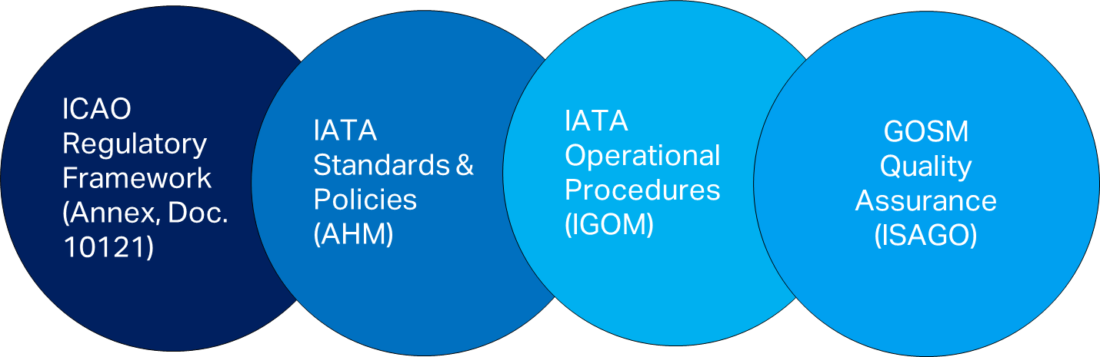
Summary of Standards Alignment
ICAO Regulatory Framework
ICAO sets global high-level standards ensuring safety and consistency in ground handling worldwide.
IATA Standards & Policies
AHM Ed.46 provides detailed from standards and policies from industries perspective for ground handling excellence.
IGOM - Operational Procedures
IGOM Ed.14 promotes operational procedures consistent execution across service providers to maintain quality and safety standards.
GOSM – Quality Assurance
GOSM provides consistent validation via ISAGO of polices, processes, and procedures implemented across service providers to maintain quality and safety standards.
Harmonized Ground Handling Standards
Safety • Operational Efficiency • Execution Consistency• Quality Assurance

Slide 12

Conclusion and Next Steps
Framework for Harmonization
ICAO Doc 10121, AHM Ed.46, and IGOM Ed.14 establish a unified framework improving ground handling safety and efficiency.
Implementation and Training
Service providers should integrate guidelines into daily operations and conduct regular staff training for compliance.
Next Steps for Improvement
Review internal procedures, update documentation, and foster collaboration for continuous operational excellence.

Slide 13
What is needed
Policies that support integration of IATA audit program into oversight activities
Collaboration to develop a flexible and balance approach to strengthen oversight of ground handling
Complement state audit programs with ISAGO audit reports
Risk Based Approach in oversight and assessment of GHSP specific risk

Slide 14

Questions?

Slide 15

Thank you
TO REPLACE IMAGE:
Click on the picture, hit Delete
Click the ‘Add Picture’ icon
Find your image & click ‘Insert’
Under the ‘Format’ tab, click the ‘Crop’ button to adjust the position within the shape
** In order for the ‘Crop’ button to appear, please make sure you keep the shape selected at all times

