Slide 1
An Update on Policy Developments and How Stakeholders Can Respond
Ronce Almond
Managing Director
International Government Affairs

Slide 2

American Airlines and the Caribbean
American is proud to be the largest carrier between the United States and Caribbean in flights, seats, and destinations
Only U.S. carrier serving all six ECCAA full member states
In 2025, American will operate 650 more departures to the Caribbean year-over-year
Miami and Charlotte hubs – geography, O&D, and connections to American Airlines and oneworld networks
Recent expansion and new service to the Caribbean
Beef Island/Tortola, British Virgin Islands
Governor’s Harbour, Bahamas
Ocho Rios, Jamaica
South Bimini, Bahamas
South Caicos, Turks & Caicos Islands

Slide 3
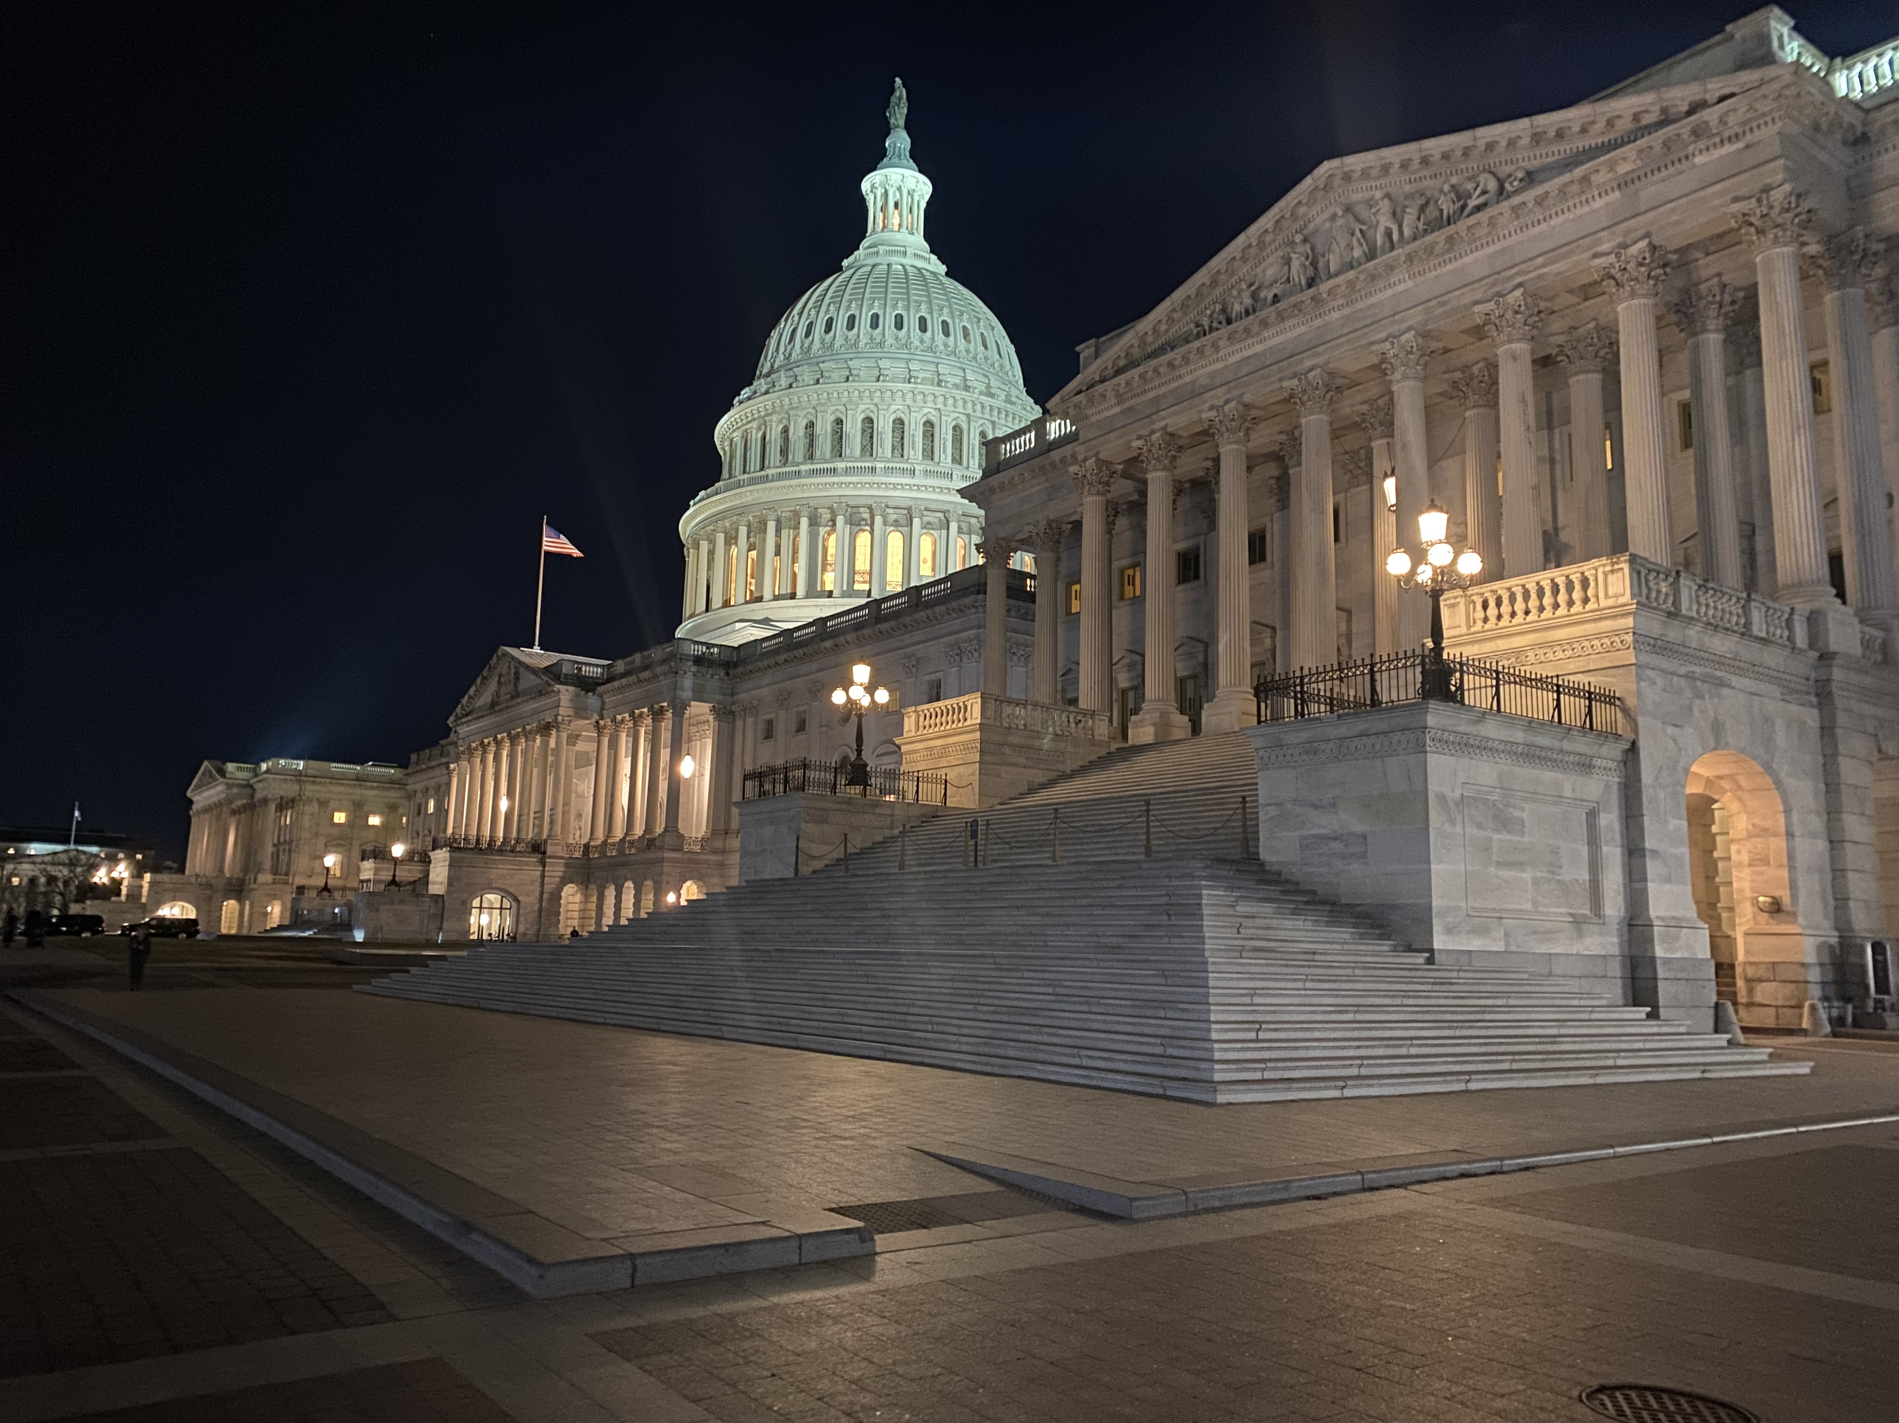
Recent Developments, Challenges, and Changes in U.S. Policy and Int’l Aviation
Open Skies Agreements
Tariffs and Trade
ATC Modernization
Geopolitical Uncertainty and Atmosphere
U.S. Government Shutdown

Slide 4



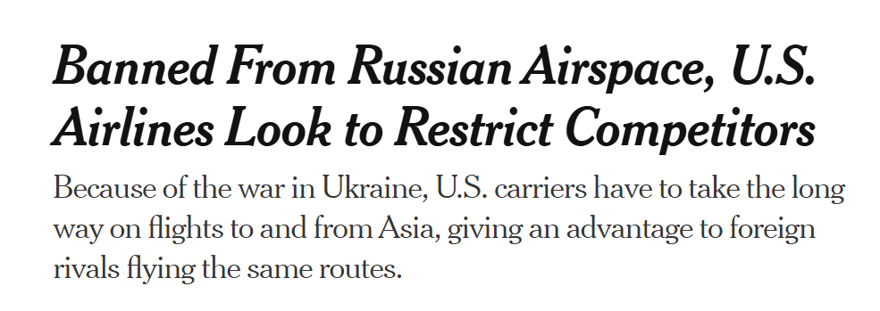





U.S. Int’l Aviation Policy, what has changed?

Slide 5








Meanwhile, back in the United States…

Slide 6
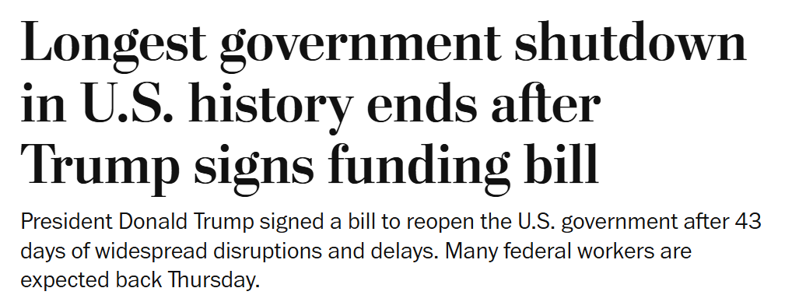
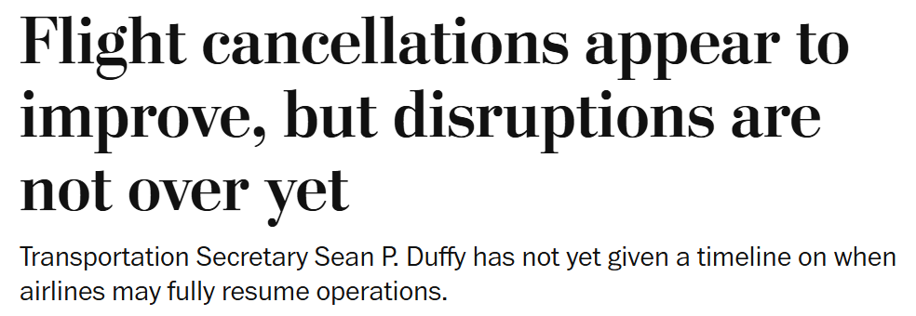
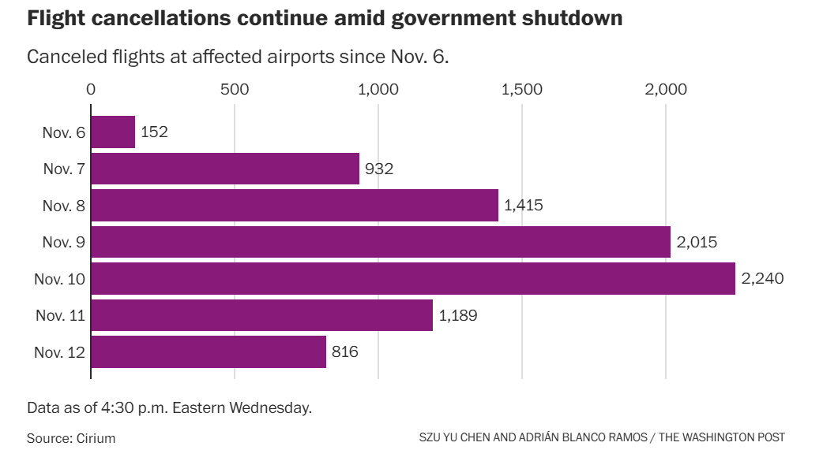

Policy is in motion….

Slide 7


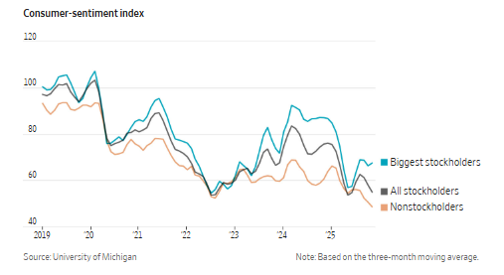
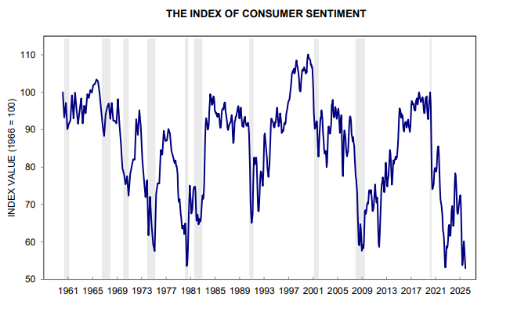



What is happening with U.S. Consumers?

Slide 8
Questions

